Slide 1

USB Rubber Ducky Attack: Hidden Admin, RDP Access, and Persistence
By Sahifa Syed

Slide 2
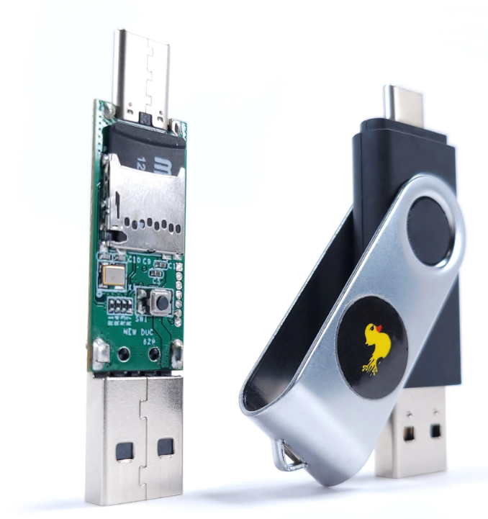
Introduction: What is a USB Rubber Ducky?
A malicious USB device that acts like a keyboard (Hak5, 2023)
Injects keystrokes to automate attacks
Often used in Red Teaming and Penetration Testing
(Hak5, 2023)

Slide 3




Objective of the Attack
Create a hidden admin account
Enable Remote Desktop (RDP)
Add persistence through scheduled tasks
Clear security logs to cover tracks

Slide 4
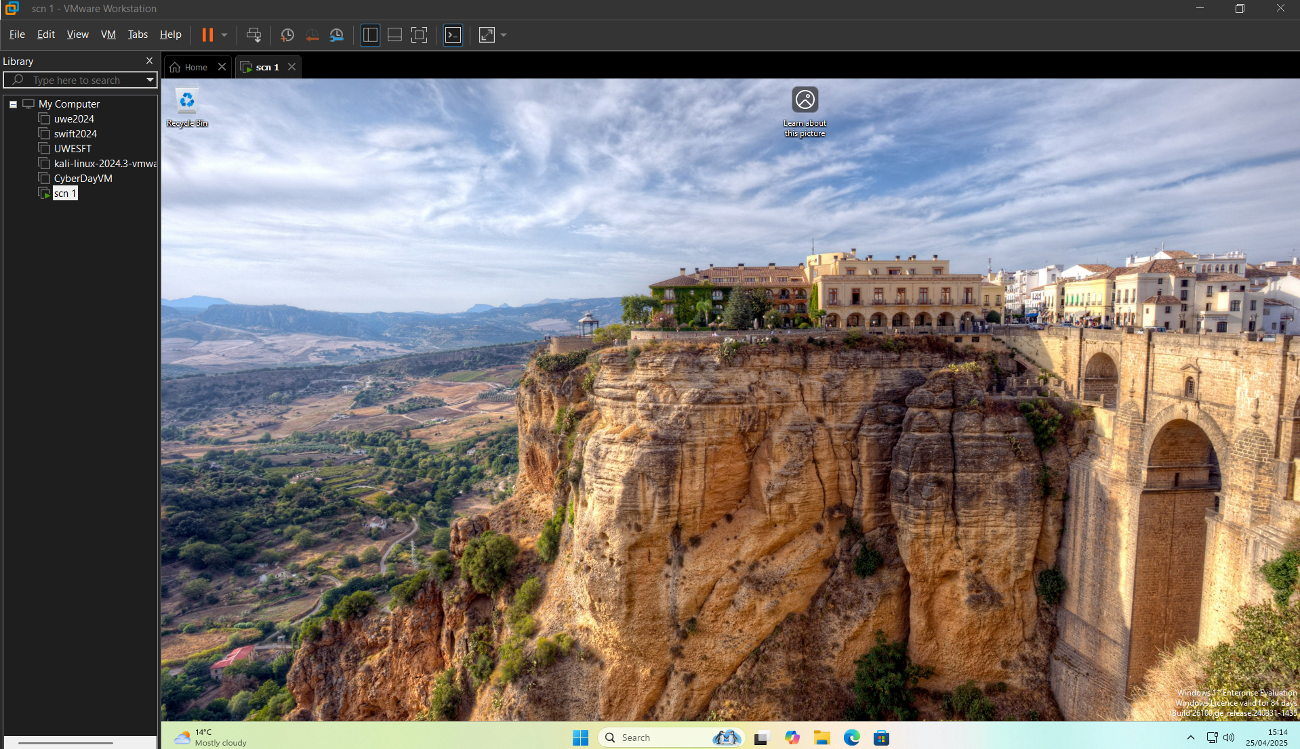
Target Environment
Fresh Windows 11 VM with full admin access
Used VMware Workstation for isolation
RDP and PowerShell available by default

Slide 5
Live Attack Demonstration

Slide 6

End Of Live Attack Demonstration
Now, Onto The Steps Used To Execute This Attack

Slide 7
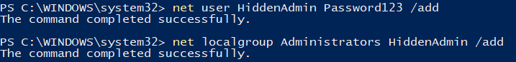
Step 1 – Create Hidden Admin Account Command(s):
Purpose: Create a new administrator account without modifying the existing ones.
Security Impact: Gives attacker full control of the system. MITRE TTP: T1078 – Valid Accounts

Slide 8
Step 2 – Hide the Admin Account Command:
Purpose: Hides the user account from the Windows login screen.
Security Impact: Makes the admin account invisible to users and harder to detect. MITRE TTP: T1098 – Account Manipulation

Slide 9
Step 3 – Enable RDP for Remote Access Commands:
Purpose: Enables Remote Desktop and opens firewall access.
Security Impact: Attacker can access the system remotely anytime. MITRE TTP: T1021 – Remote Services

Slide 10
Step 4 – Add Persistence with Scheduled Task Command:
Purpose: Ensures RDP is always re-enabled every time the system logs in.
Security Impact: Maintains long-term access even after reboot. MITRE TTP: T1053 – Scheduled Task

Slide 11
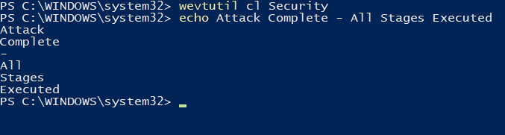
Step 5 – Clear Security Logs Command:
Purpose: Deletes all security event logs.
Security Impact: Erases evidence of the attack from log files. MITRE TTP: T1070 – Indicator Removal on Host

Slide 12

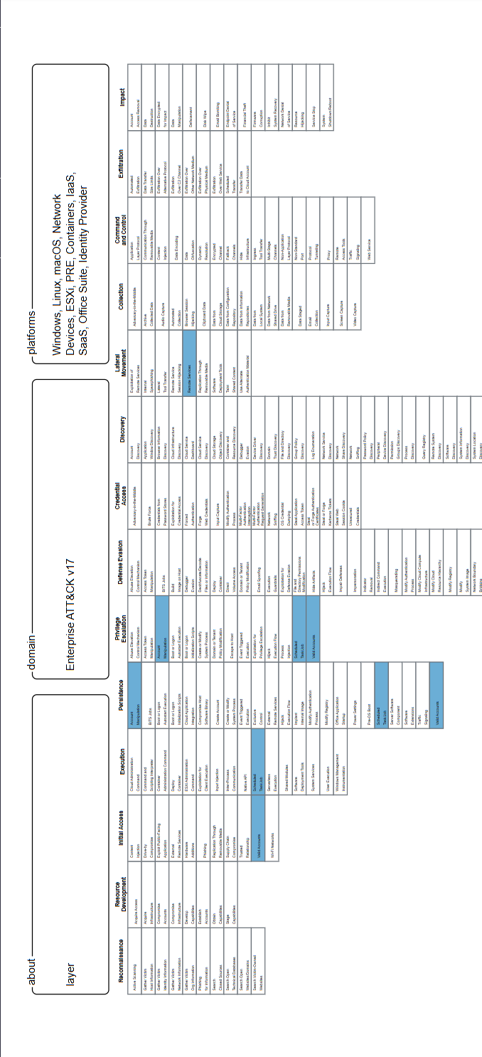
MITRE ATT&CK Mapping
MITRE Technique ID | Technique Name | Description
T1059 | Scripting (PowerShell) | Used to execute arbitrary commands/scripts.
T1078 | Valid Accounts | Abuse of valid accounts to gain unauthorized access.
T1053 | Scheduled Task | Create scheduled tasks for persistence.
T1021 | Remote Services | Use of RDP for lateral movement or persistence.
T1070 | Clear Logs | Deletion of logs and artifacts to hide traces.
T1098 | Account Manipulation | Creation or modification of user accounts to maintain access.
(Mitre Corporation, 2024)

Slide 13
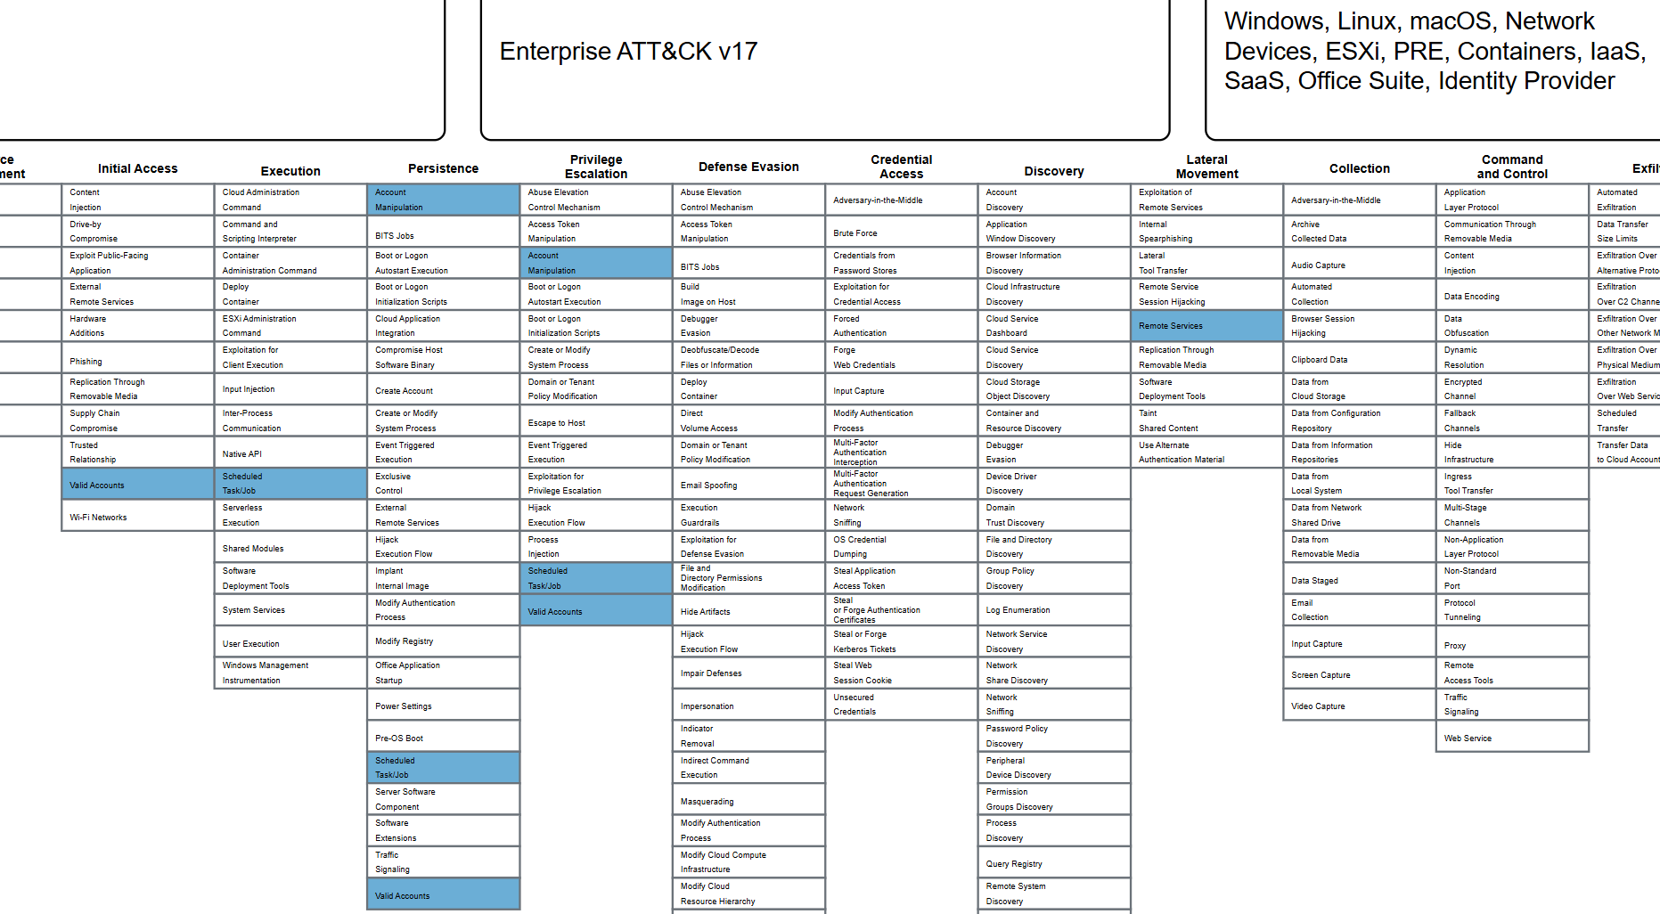
MITRE ATT&CK Framework Mapping (Highlighted Techniques)
(Mitre Corporation, 2024)

Slide 14
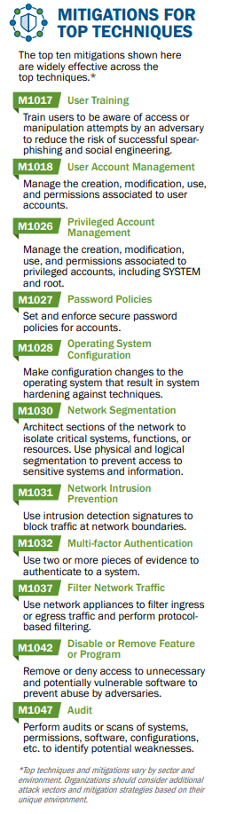

Mitigation Strategies
M1018 : User Account Management
✅ Enforce Group Policy to block unauthorized account creation ➡️ Prevents stealth creation of HiddenAdmin account
M1036 : Account Use Policies
✅ Monitor for hidden user accounts via registry monitoring ➡️ Detects stealthy manipulation of SpecialAccounts\UserList
M1035 : Limit Access to Remote Services
✅ Restrict RDP access, enforce MFA ➡️ Blocks unauthorized remote desktop connections
M1047 : Audit
✅ Monitor scheduled task creation and event log clearing ➡️ Detects suspicious persistence and forensic tampering
M1027 : Password Policies
✅ Enforce strong passwords and regular rotation ➡️ Makes brute-forcing or guessing admin credentials harder
(Mitre Corporation, 2024)

Slide 15



Conclusion
Real-world impact with low complexity
Easy to execute, hard to detect
Demonstrates the need for better USB policy enforcement

Slide 16
References
Hak5. (2023) USB Rubber Ducky Documentation. [online] Available at: https://docs.hak5.org/ [Accessed 13 Feb. 2025].
Microsoft. (2024) wevtutil command-line reference. [online] Available at: https://learn.microsoft.com/en-us/windows-server/administration/windows-commands/wevtutil [Accessed 18 Feb. 2025].
Microsoft. (2024) Group Policy Overview. [online] Available at: https://learn.microsoft.com/en-us/windows-server/identity/ad-ds/get-started/group-policy-overview [Accessed 18 Feb. 2025].
Mitre Corporation. (2024) MITRE ATT&CK Framework. [online] Available at: https://attack.mitre.org/ [Accessed 24 Feb. 2025].
Microsoft. (2024) Configure RDP and firewall rules. [online] Available at: https://learn.microsoft.com/en-us/windows-server/remote/remote-desktop-services/clients/remote-desktop-allow-access [Accessed 01 Mar. 2025].
Splunk Inc. (2024) Monitor Windows Event Logs. [online] Available at: https://www.splunk.com/en_us/blog [Accessed 03 Mar. 2025].
Cisco. (2024) USB Threat Protection Best Practices. [online] Available at: https://www.cisco.com/c/en/us/about/security-center/usb-threat-protection.html [Accessed 10 Mar. 2025].
SANS Institute. (2024) Detecting Malicious Scheduled Tasks. [online] Available at: https://www.sans.org/blog/detecting-malicious-scheduled-tasks/ [Accessed 15 Mar. 2025].

Slide 17

Thank You For Watching ☺

